Slide 1


Our Success is to know even one life has breathed easier because of our efforts. We are here for you.
Cloud Racer Team
Health Planner Application

Slide 2

AGENDA
Overview of Application
Overall Architecture of the Solution
Demo of the Application
DevOps Implementation
Summary

Slide 3
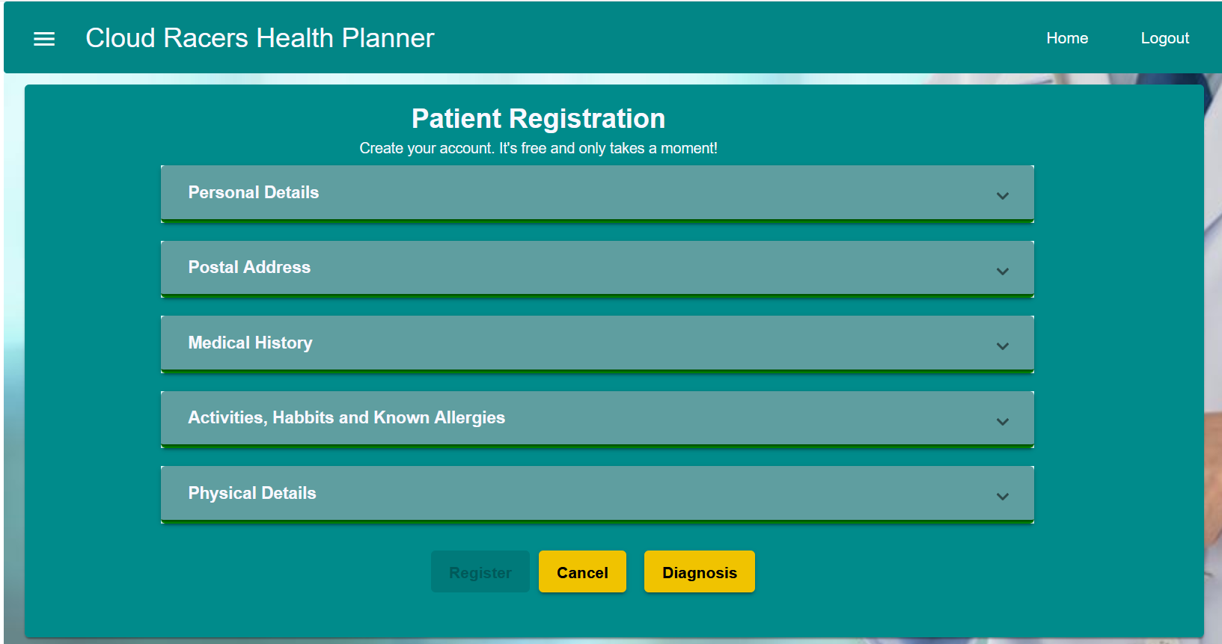
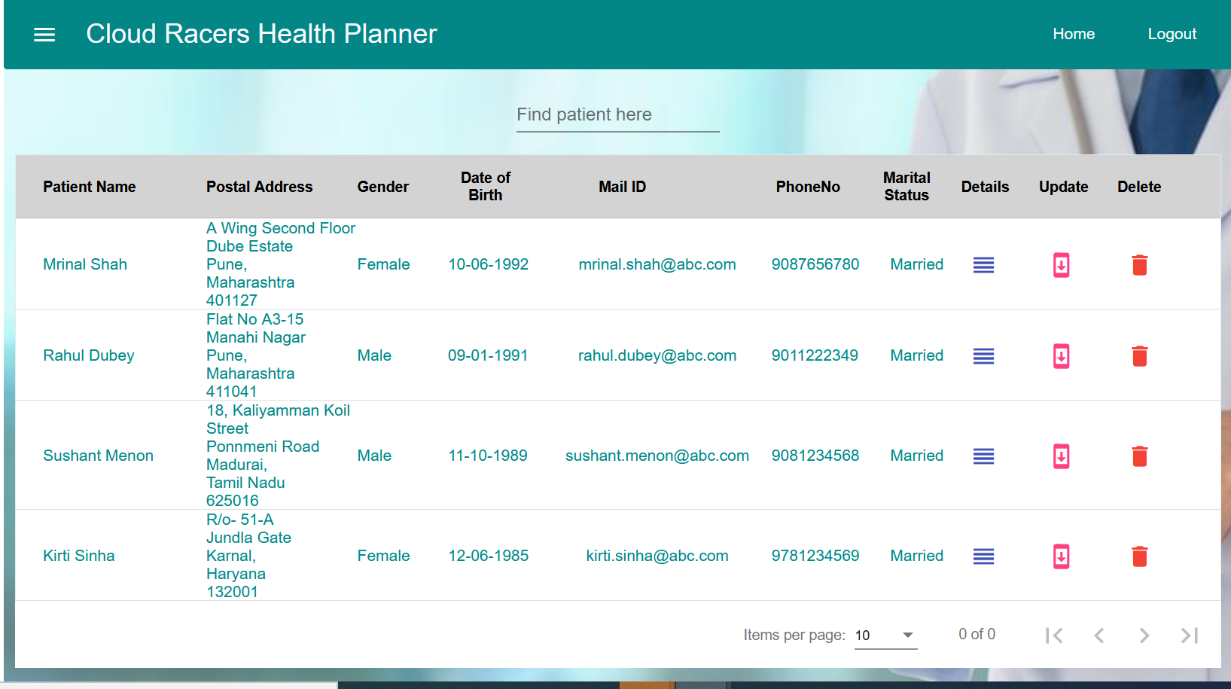
overview
Register Patients
View list of patients
Ability for Patients using a secure
login to self register on the Portal

Slide 4
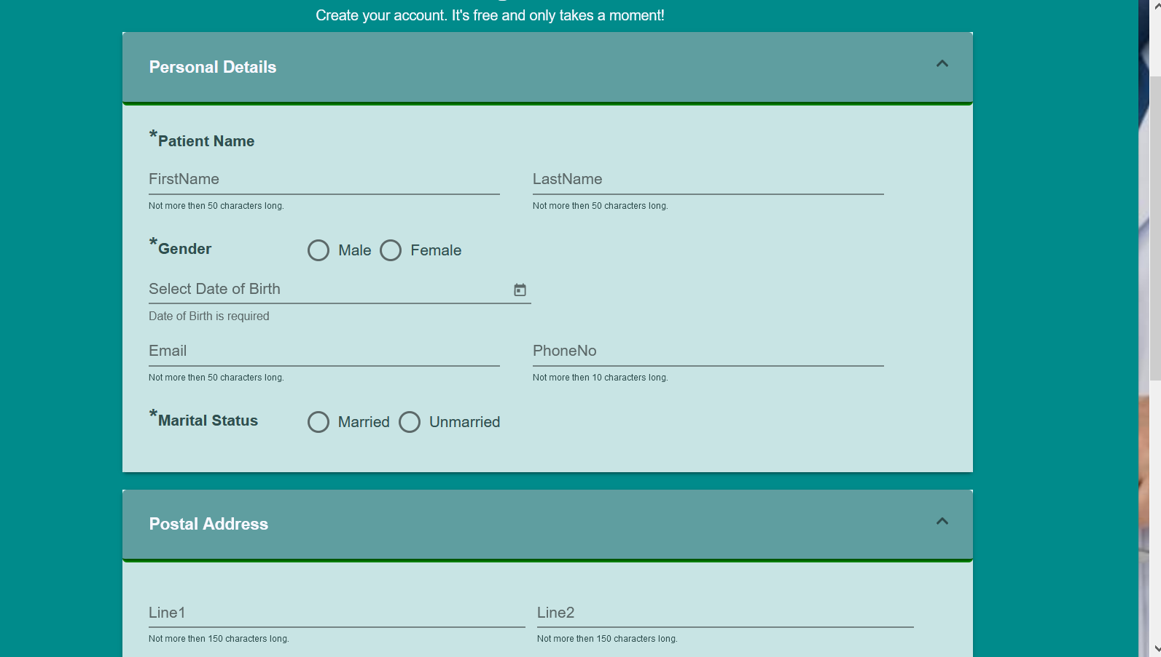
User friendly UI with a new look and feel
Ability for Patients using a secure
login to self register on the Portal

Slide 5
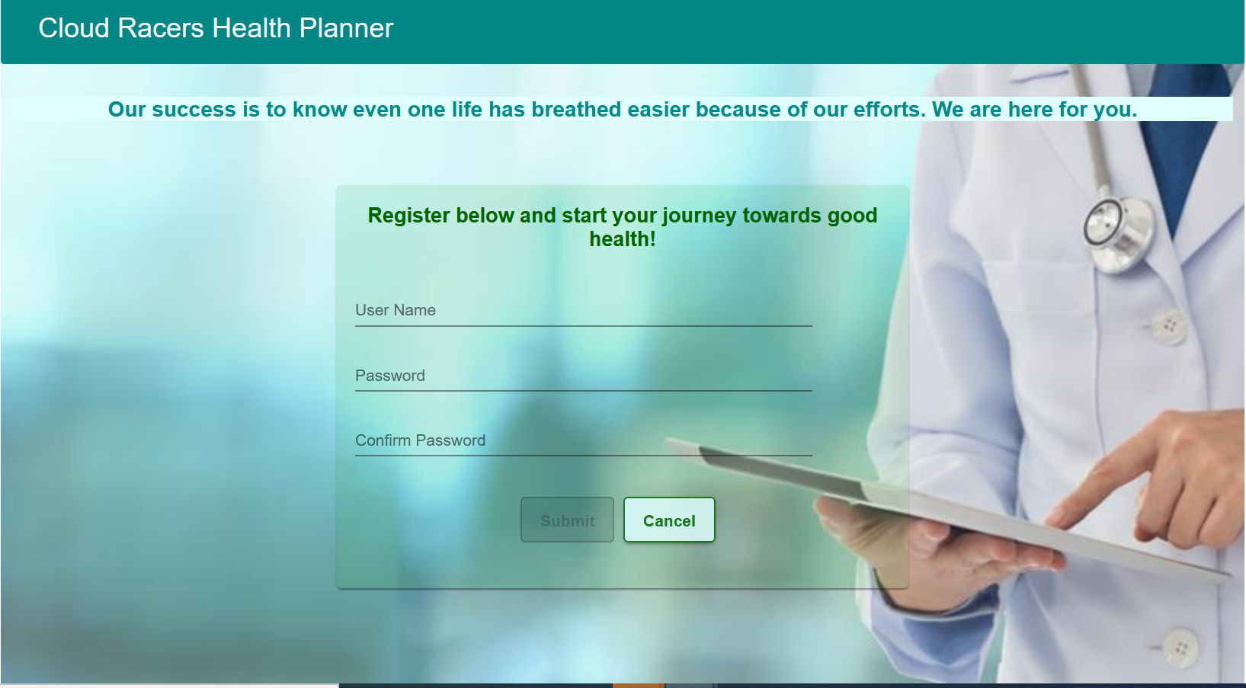
SELF REGISTER
&
Secure login

Slide 6

Upload- medical reports

Slide 7
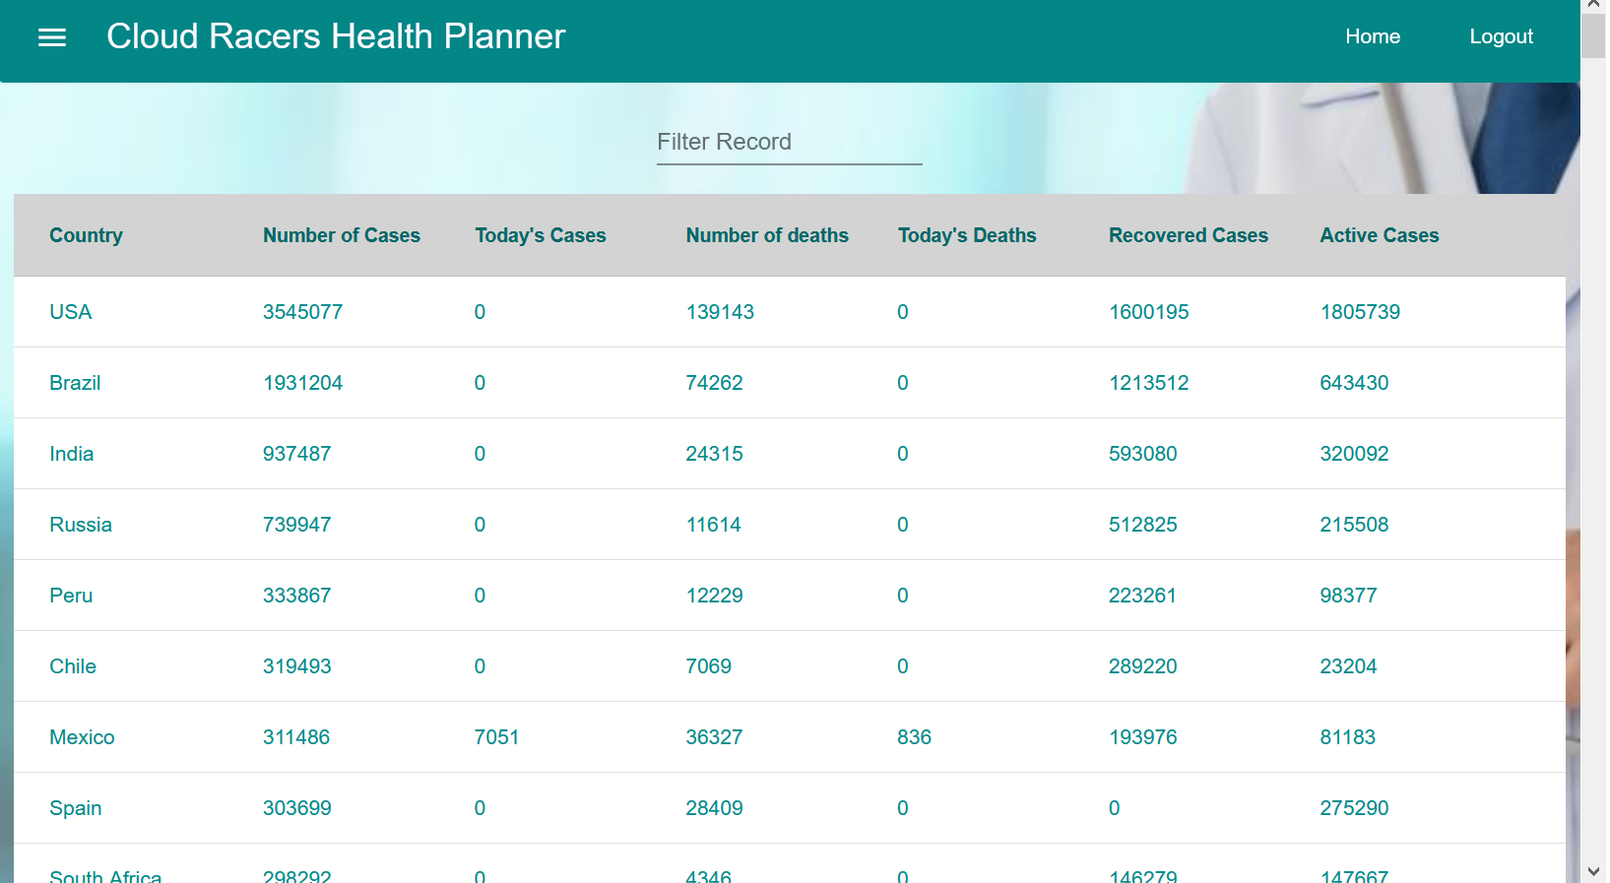
COVID-19 DATA
COVID DATA
5
Ability to view COVID data
Real time

Slide 8
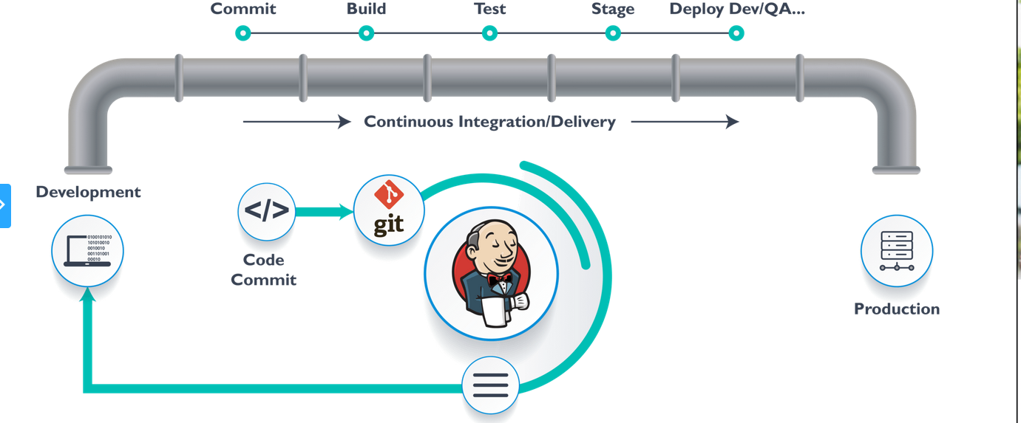
CI/CD Pipeline
COVID DATA
5
Ability to view COVID data
Real time

Slide 9
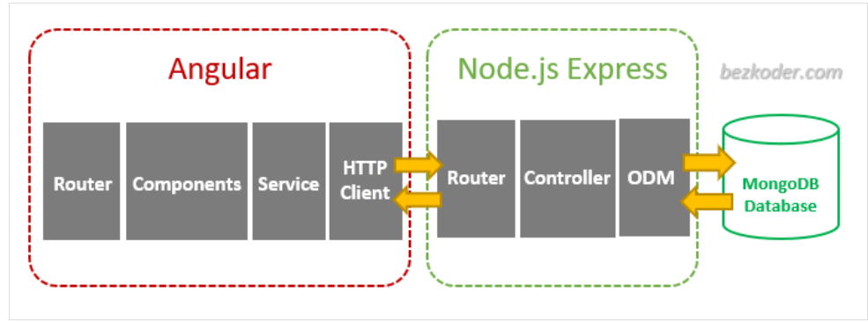
Application build using Angular JS, Python and Mongo DB
Hosted on the Red Hat Cluster on IBM cloud
Application integrated with API Manager and Watson services hosted on IBM Cloud
Continuous Interpretation - Jenkins hosted on Private cloud.
Technical Solution Overview

Slide 10

sprints
Sprint – I (06 Apr-25 April-2020)
Learning
Sprint – II (27 April- 16 May)
Architect & Prototype
Sprint– III (18 May-12 June)
Build and Integrate the Solution
Sprint– IV (15 June-04 July)
Implement the CI/CD Pipeline
Sprint - I
IBM Learning
Knowledge Sharing sessions
Sprint - II
Implement Seed Project on OpenShift Cluster
Build the Overall Architecture
Prototype the User Interface
Sprint - III
Implement the API Manager
Implement the Watson Service
Implement the COVID API
Implement the new UI
Integrate the application
Sprint - IV
Implement the CI/CD Pipeline
Test and fix the Issues

